Slide 1


Signal Processing
Audacity

Slide 2


EZCR VAD

Slide 3



Slide 4
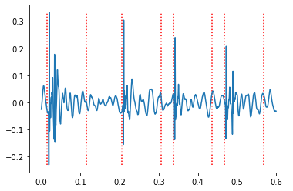

Slide 5
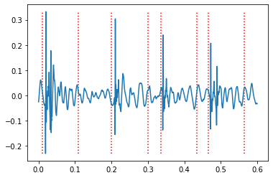
NLEO Segmentation

Slide 6
What’s next

